Slide 1
Solidity Contracts
Loke KS

Slide 2
Introduction
An Ethereum blockchain is a globally shared, transactional database.
This means that everyone can read entries in the database just by participating in the network.
If you want to change something in the database, you have to create a so-called transaction which has to be accepted by all others.
The word transaction implies that the change you want to make (assume you want to change two values at the same time) is either not done at all or completely applied.
Furthermore, while your transaction is being applied to the database, no other transaction can alter it.

Slide 3
Transactions
The transactional action implies that the change you want to make (assume you want to change two values at the same time) is either not done at all or completely applied.
Furthermore, while your transaction is being applied to the database, no other transaction can alter it.
If a transfer from one account to another is requested, the transactional nature of the database ensures that if the amount is subtracted from one account, it is always added to the other account.
If due to whatever reason, adding the amount to the target account is not possible, the source account is also not modified.

Slide 4
Transactions
A transaction is always cryptographically signed by the sender (creator). This makes it straightforward to guard access to specific modifications of the database.
In the example of the electronic currency, a simple check ensures that only the person holding the keys to the account can transfer money from it.

Slide 5
Transactions
A transaction is a message that is sent from one account to another account which might be the same account or is an empty account (no address).
If the target account contains code, that code is executed and the payload is provided as input data.
If the target account is not set (the transaction does not have a recipient or the recipient is set to null), the transaction creates a new contract.

Slide 6
Transactions
Transactions contain:
The recipient of the message (destination address)
A signature identifying the sender
The amount of ether to transfer from the sender to the recipient
An optional data field (arguments for smart contract function)
A STARTGAS value, representing the maximum number of computational steps the transaction execution is allowed to take
A GASPRICE value, representing the fee the sender pays per computational step
A nonce

Slide 7
Contract Creation
The address of a contract is not the zero address but an address derived from the sender and its number of transactions sent (the “nonce”).
The payload of such a contract creation transaction is taken to be EVM bytecode and executed.
The output data of this execution is permanently stored as the code of the contract.
This means that in order to create a contract, you do not send the actual code of the contract, but in fact code that returns that code when executed.

Slide 8
Gas
Upon creation, each transaction is charged with a certain amount of gas, whose purpose is to limit the amount of work that is needed to execute the transaction and to pay for this execution at the same time.
The STARTGAS and GASPRICE fields are crucial for Ethereum's anti-denial of service model.
+In order to prevent accidental or hostile infinite loops or other computational wastage in code, each transaction is required to set a limit to how many computational steps of code execution it can use.
While the EVM executes the transaction, the gas is gradually depleted according to specific rules.

Slide 9
Gas
The gas price is a value set by the creator of the transaction, who has to pay gas_price * gas up front from the sending account.
If some gas is left after the execution, it is refunded to the creator in the same way.
If the gas is used up at any point (i.e. it would be negative), an out-of-gas exception is triggered, which reverts all modifications made to the state in the current call frame.

Slide 10
Calls
While transactions are the only way to perform a change in the Ethereum blockchain, they are not the only way to interact with smart contracts.
Any off-chain client can perform a query on a smart contract by making a static call to it.
Calls are different from transactions in that they do not need to be signed and are not broadcasted to the Ethereum network, and thus cannot make any changes to the blockchain state and do not cost any gas.
Calls are always resolved by the node that receives them and are only used for querying data from a smart contract

Slide 11
Calls
A call executes smart contract code just like a transaction does, the only difference is that any changes performed during a call are not persisted, and the return value of a call is sent back to the sender
Unlike transactions, where the sender has no way to get a return value back.

Slide 12
Storage
The Ethereum Virtual Machine has three areas where it can store data- storage, memory and the stack.
Each account has a data area called storage, which is persistent between function calls and transactions.
Storage is a key-value store that maps 256-bit words to 256-bit words.
It is not possible to enumerate storage from within a contract, it is comparatively costly to read, and even more to initialize and modify storage.
The storage space in a smart contract, it is extremely large: it is an addressable space of 2²⁵⁶ slots of 32 bytes each.

Slide 13
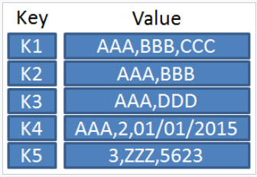
Storage: Key-Value
A key-value store, or key-value database is a simple database that uses an associative array where each key is associated with one and only one value in a collection.
The key acts as the index to retrieve the value.
Think of a dictionary where the word is used as the key, and the word definitions as the value

Slide 14
Storage Cost
The more data or larger the amount of storage, the higher the transaction cost in terms of fuel.
However, storage in an Ethereum network is not time bound; it’s a one-time payment, and data could be there forever.
Reading data from the network is free.
The cost of each instruction in a smart contract will limit the amount of storage it uses

Slide 15
Storage
Because storage is costly, you should minimize what you store in persistent storage
Use it to store what is really essential for the contract needs to run.
Store data like derived calculations, caching, and aggregates outside of the contract.
A contract can neither read nor write to any storage apart from its own.

Slide 16
Memory
Since storage usage is expensive, the EVM also provides another 256-bit-addressable transient space called the memory
A contract obtains a freshly cleared instance for each message call.
Memory is limited to reads at the 256-bit width, while writing can be either 8 or 256 bits wide.
It is used to hold temporary values. Memory cannot be used at the contract level. It is erased between (external) function calls and is cheaper to use.
At the time of expansion, the cost in gas must be paid. Memory is more costly the larger it grows (it scales quadratically).

Slide 17
Stack
All computations are performed on a data area called the stack.
It has a maximum size of 1024 elements and contains words of 256 bits.
In addition to arrays and structs, all other local variables of most value types are stored in stack
A stack only allows you to access the top level elements.
It is not possible to just access arbitrary elements deeper in the stack without first removing the top of the stack.

Slide 18
Ethereum Accounts
In Ethereum, the state is made up of objects called "accounts", with each account having a 20-byte address.
An Ethereum account contains four fields:
The nonce, a counter used to make sure each transaction can only be processed once
The account's current ether balance
The account's contract code, if present
The account's storage (empty by default)

Slide 19
Contracts
“Contracts" in Ethereum should not be seen as something that should be "fulfilled" or "complied with“
Contracts are more like "autonomous agents" that live inside of the Ethereum execution environment executing a specific piece of code when “called" by a message or transaction
Contracts have direct control over their own ether balance and their own key/value store to keep track of persistent variables.

Slide 20
Code and State
A smart contract has two main properties: its code and its state.
A contract’s state is composed of its
ETH balance (since all Ethereum addresses have an associated balance) and
Storage (where the value of its variables is persisted).
The code is run every time a transaction is received by the contract, and has access to the contract’s local storage, and the transaction’s context.

Slide 21
Contract ABI
When a contract is compiled, there are two items of interest:
ABI (application binary interface) – The ABI is a JSON string that list the function names and parameters belonging to this contract
Bytecode – When a contract is compiled, it is compiled into opcodes. The opcodes can be interchangeably represented by its hexadecimal counterparts called bytecodes
You can view this in Remix after compilation

Slide 22
Account Balance
All address types in Ethereum, regardless of being externally owned accounts or smart contracts, have an associated balance in ETH. Ethereum provides primitives for querying such balances (both from within a smart contract and from outside the network), and for easily transferring it.

Slide 23
Solidity
Solidity is a Turing complete programming language that runs on the Ethereum Virtual Machine (EVM). By Turing complete we mean that it is a full-fledged programming language that is capable of implementing any algorithms.
The EVM is the computing layer that runs Solidity programs after it is compiled.
Solidity is an object-oriented programming language.

Slide 24
Special properties
Each function call has an associated property (there are other properties as well) that identifies the account that initiates the call.
This is the msg.sender property that tracks who made the call.
It is possible by using this property to only allow certain accounts to execute this call.
This would allow access control over function calls.
For example, the token mint function has to be restricted to only the contract creator or owner

Slide 25
DelegateCal
A regular CALL from one contract to another in the EVM works as a call from an actor or process to another: a new context is created, where the state (storage and balance) of the callee is loaded, the caller is set to msg.sender, and the code of the callee is executed.
On the other hand, a DELEGATECALL works by executing the code of the callee but maintaining the original context of the caller. In other words, storage, balance, and even msg.sender are not changed by a DELEGATECALL – only the code being executed is.
This low-level instruction allows us to jump into an arbitrary contract and execute its code,

Slide 26
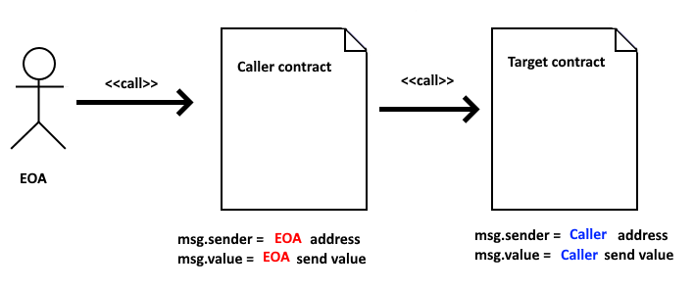
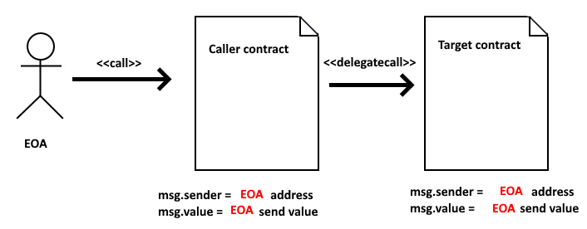
Call & DelegateCall

Slide 27
Address datatype
Account addresses are 20-byte constants within the language. These represent the externally owned accounts (owned by external entities such as a person) and contract addresses. They can be assigned to variables.
It is possible to call the address for its balance or to transfer funds. For example, you can call:
<address>.balance()
<address>.transfer(10)
<address>.send(10)
Additionally there is call() and delegatecall()

Slide 28
Address datatype
Solidity differentiates addresses into two separate types: address and address payable.
Casting address to payable: payable(address) provides the transfer method for sending ETH to it.
Or using address payable
This allows you rely on the type system to decide which addresses should be allowed to receive funds from your contracts.
A non-payable address only provides a balance property to query its ETH balance

Slide 29
Address datatype
An address is 20 a byte value size (160 bits or 40 hex characters).
It corresponds to the last 20 bytes of the Keccak-256 hash of the public key.
An address is always pre-fixed with 0x as it is represented in hexadecimal format.
Address values are case-insensitive
To define a variable of address type, specify the keyword address in front of the variable name (owner and user is a variable)
address owner = 0xc0ffee254729296a45a3885639AC7E10F9d54979
address user = msg.sender

Slide 30
Address datatype
address owner = 0xc0ffee254729296a45a3885639AC7E10F9d54979
address payable user = msg.sender
owner.balance
user.transfer(10) #send 10 Wei to user using 2300 gas, reverts on failure
user.send(10) #send 10 Wei to user using 2300 gas, returns false on failure
All contracts can be converted to address type, so it is possible to query the balance of the current contract using address(this).balance.
1 ether = 1,000,000,000,000,000,000 wei (10¹⁸)
// look-up balance from the current contract (Method 2)
uint public contract_balance = address(this).balance;

Slide 31
Events
Solidity provides an abstraction over transaction logs named events
A Solidity event can only be emitted and can’t be observed within a smart contract
The event is declared using the event keyword and fired using emit
Events are useful not just for monitoring a contract for changes but also as a replacement for return values in a transaction.
Since it is not possible for a client to retrieve a return value from a method called in a transaction, it is common to emit an event with the value that needs to be obtained.
The client then retrieves the events attached to the transaction receipt and extracts the value from there

Slide 32
Checking Balance
// Show me my money !
address my_account = msg.sender;
uint my_ether_balance = my_account.balance;
// or accessed directly
uint my_ether_balance = msg.sender.balance;
// look-up balance from the current contract (Method 2)
uint public contract_balance = address(this).balance;
// send the amount to another payable address
payable_address.transfer(my_ether_balance)

Slide 33
Receiving ETH
A contract can send and receive ETH.
A contract that receives ETH need to have a function that is marked external payable
You can send ETH to a contract without naming a function if the contract has either:
fallback () external payable
receive() external payable
Both of these functions have only 2300 gas stipends so it can’t have complex functions within. Most of the time it is just an empty function.

Slide 34
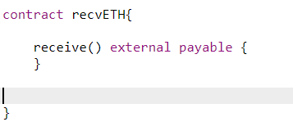
Receiving ETH
This contract can receive ETH from Metamask

Slide 35
Layout of a Solidity Source File
Source files can contain an arbitrary number of contract definitions, import directives, pragma directives and struct, enum, function and constant variable definitions.
The pragma keyword is used to enable certain compiler features or checks. A pragma directive is always local to a source file, so you have to add the pragma to all your files if you want to enable it in your whole project.
The version pragma is used as follows: pragma solidity ^0.5.2;

Slide 36
Importing other Source Files
At a global level, you can use import statements of the following form:
import "filename";

Slide 37
Structure of a Contract
A contract is declared with the keyword contract. Within a contract statement you can have state variables and functions.
Functions are the executable units of code. Functions are usually defined inside a contract, but they can also be defined outside of contracts.

Slide 38
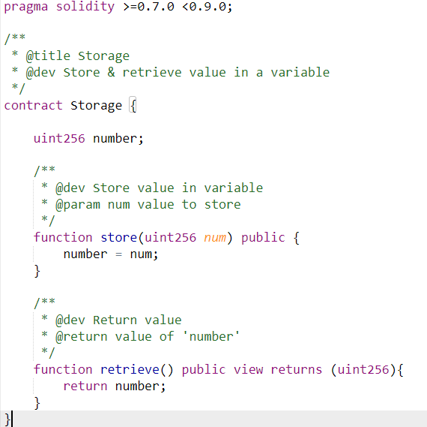
Contract
Statements must terminate with semicolon
Name of contract – can be any name
Functions for contract
“return” indicates that a value will presented after function completes execution

Slide 39
Comments
Single-line comments (//) and multi-line comments (/*...*/) are possible.
// This is a single-line comment.
/*
This is a
multi-line comment.
*/

Slide 40
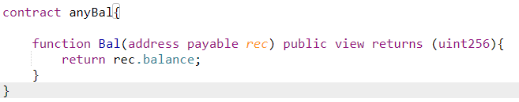
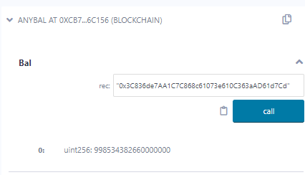
Function
Public means available for external entities to call (activate this function
Input Parameter
You key in value here

Slide 41
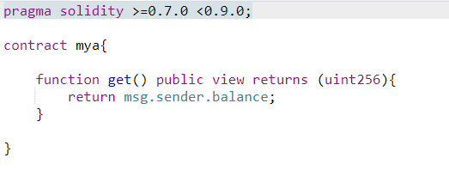
Another Contract
This contracts allows you to check the account balance of the caller of the contract

Slide 42
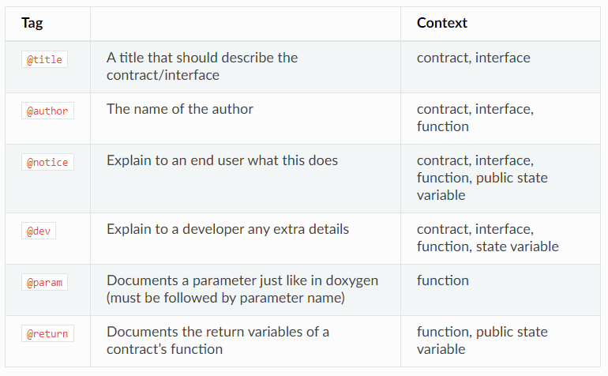
Ethereum Natural Language Specification Format (NatSpec).

